Slide 1
Programming pradgism - Functional programming -
Function syntax

Slide 2
Intro
x if … then … else
x for … loop
v pattern matching
v guard, where
v case
These syntaxes are developed in recent other languages versions, like Python 3.10

Slide 3
1. Pattern matching
lucky :: (Integral a) => a -> String
lucky 7 = "LUCKY NUMBER SEVEN!"
lucky x = "Sorry, you're out of luck, pal!"

Slide 4
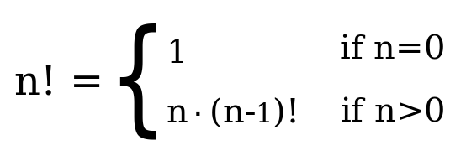
1. Pattern matching: recursion

Slide 5
1. Pattern matching: recursion
factorial :: (Integral a) => a -> a
factorial 0 = 1
factorial n = n * factorial (n - 1)

Slide 6
1. Pattern matching: Non-exhaustive patterns
charName :: Char -> String
charName 'a' = "Albert"
charName 'b' = "Broseph"
charName 'c' = "Cecil"

Slide 7
1. Pattern matching: boundary condition
length' :: (Num b) => [a] -> b
length' [] = 0
length' (_:xs) = 1 + length' xs

Slide 8
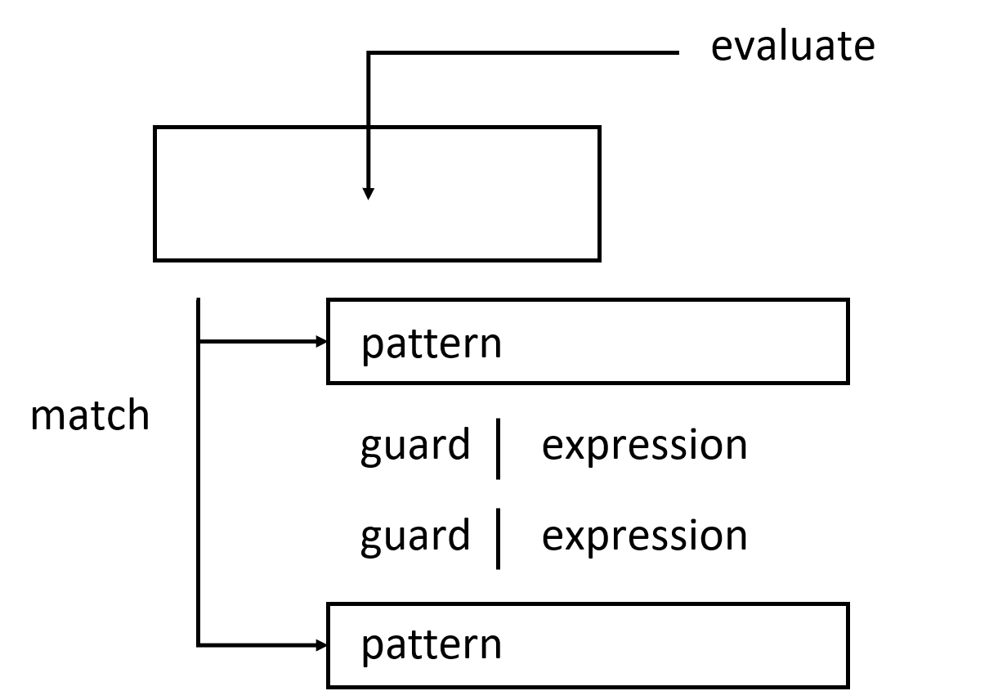
2. Guard

Slide 9
2. Guard
bmiTell :: (RealFloat a) => a -> String
bmiTell bmi
| bmi <= 18.5 = “Underweight"
| bmi <= 25.0 = “Normal"
| bmi <= 30.0 = “Fat"
| otherwise = “Overweight"

Slide 10
2. Guard
bmiTell :: (RealFloat a) => a -> a -> String
bmiTell weight height
| weight / height ^ 2 <= 18.5 = "Underweight"
| weight / height ^ 2 <= 25.0 = “Normal"
| weight / height ^ 2 <= 30.0 = “Fat”
| otherwise = “Overweight"

Slide 11
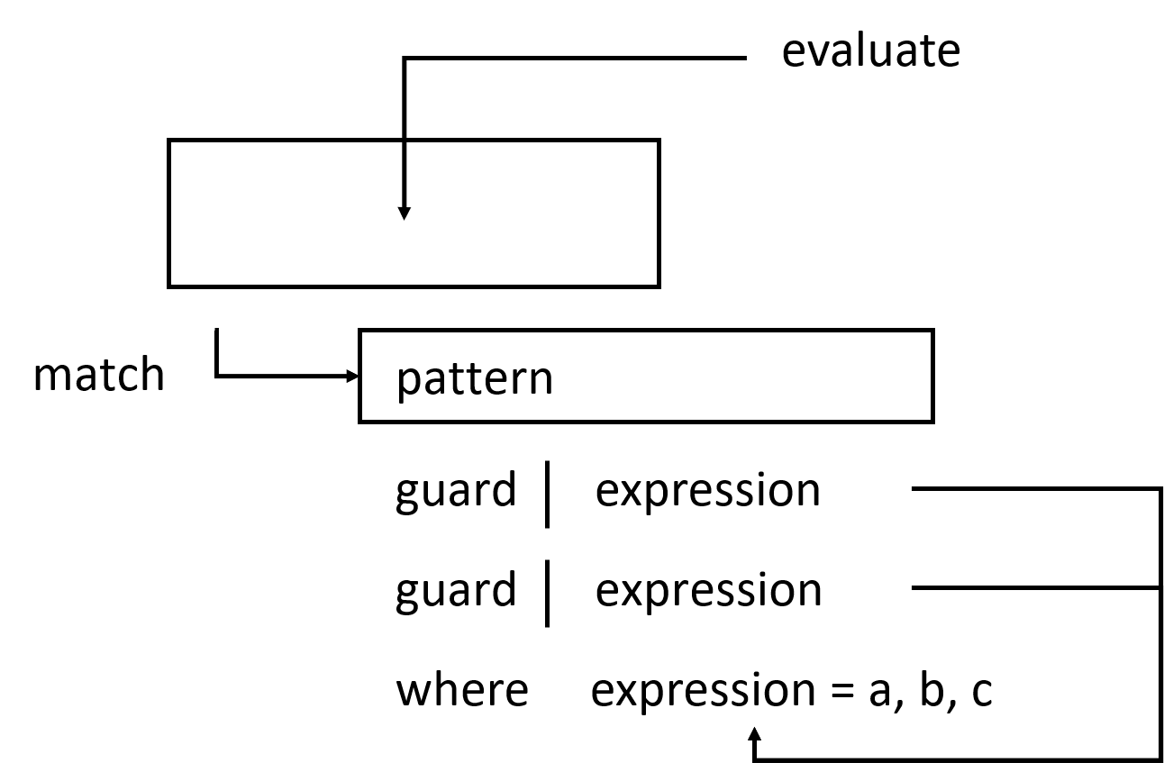
3. Where

Slide 12
3. Where
bmiTell :: (RealFloat a) => a -> a -> String
bmiTell weight height
| bmi <= 18.5 = “Underweight"
| bmi <= 25.0 = “Normal"
| bmi <= 30.0 = “Fat"
| otherwise = “Overweight"
where bmi = weight / height ^ 2

Slide 13
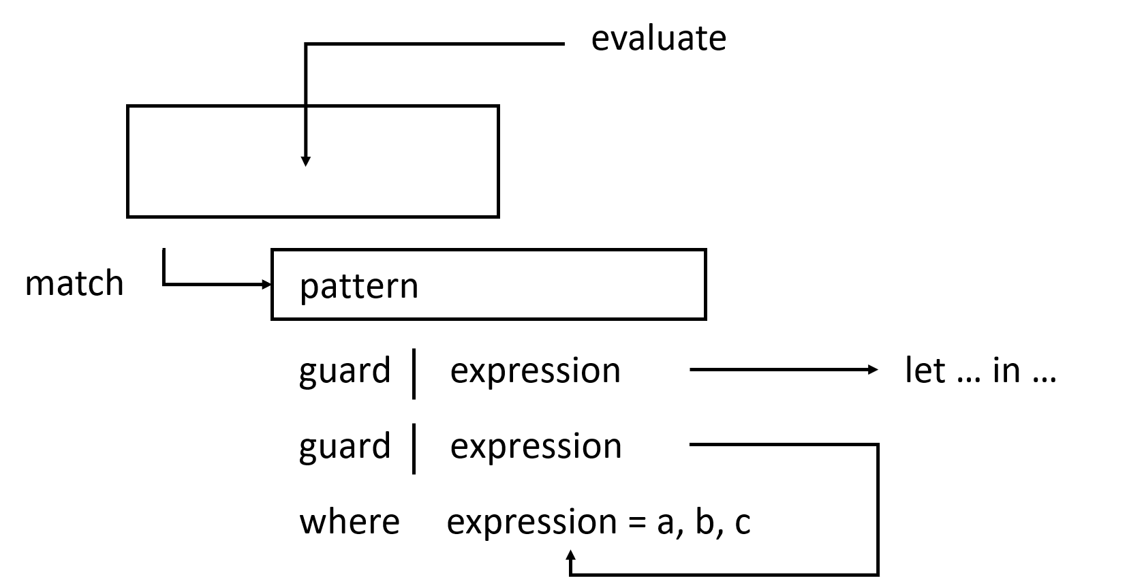
4. Let … in …

Slide 14
4. Let … in …
cylinder :: (RealFloat a) => a -> a -> a
cylinder r h =
let sideArea = 2 * pi * r * h
topArea = pi * r ^2
in sideArea + 2 * topArea

Slide 15
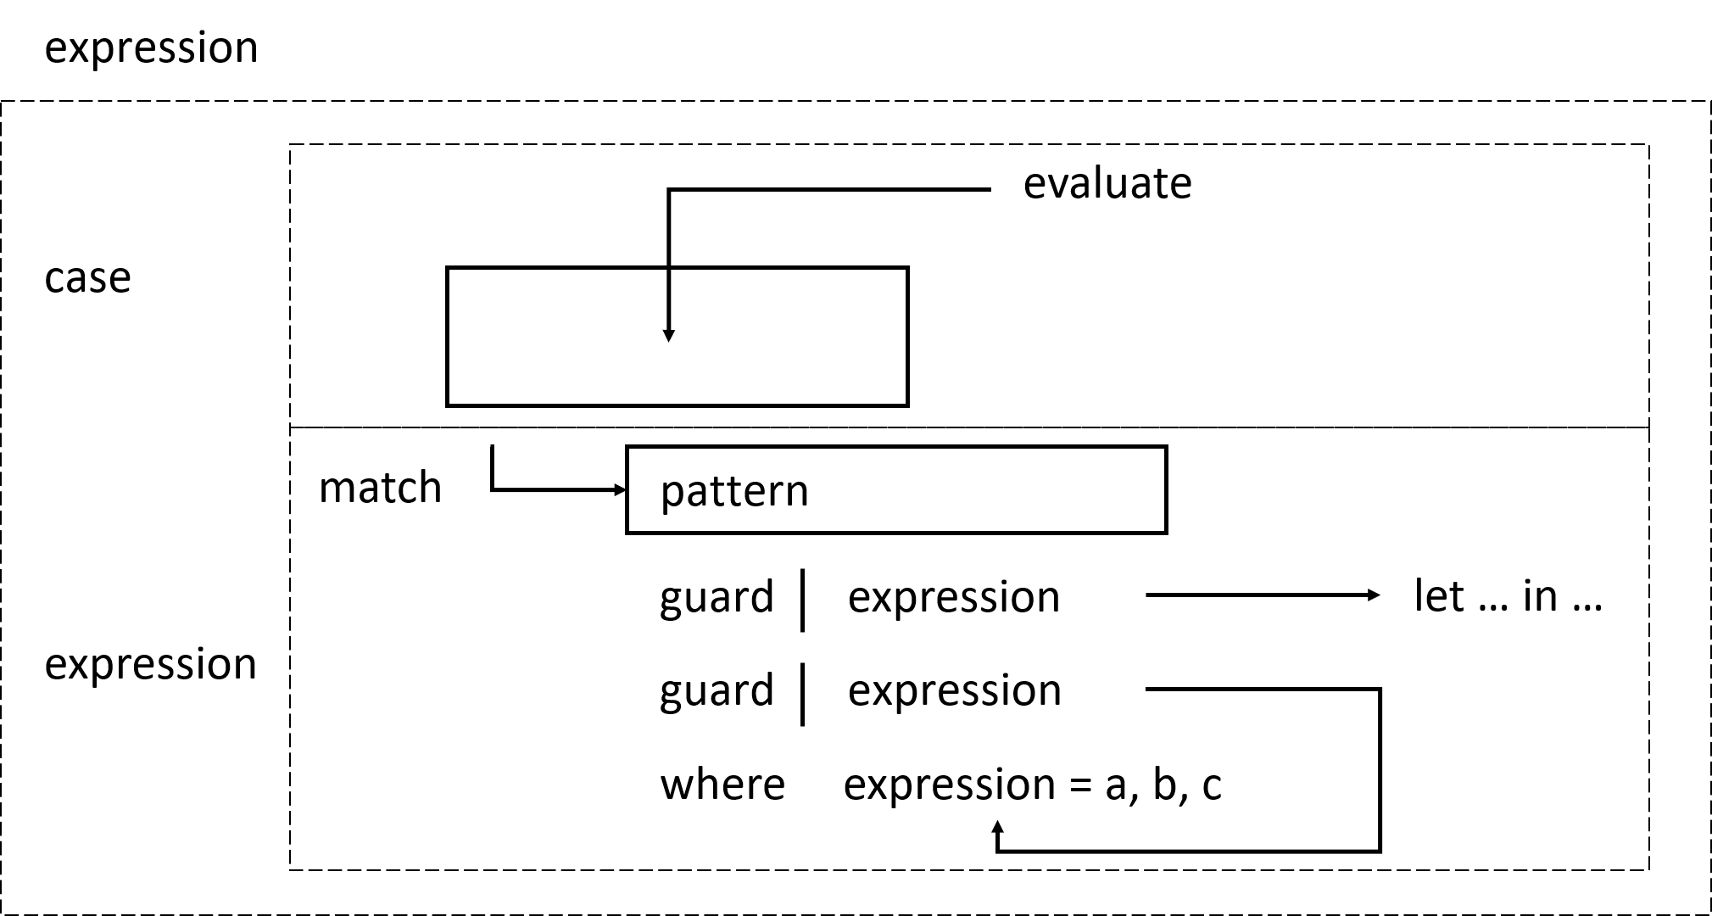
4. Case expression

Slide 16
4. Case experession
case expression of pattern -> result
pattern -> result
pattern -> result
...

Slide 17
4. Case experession
-- Pattern matching
head' :: [a] -> a
head' [] = error "No head for empty Lists!"
head' (x:_) = x
-- Case expression
head' :: [a] -> a
head' xs = case xs of [] -> error "No head for empty Lists!"
(x:_) -> x

